Slide 1







Team 1: The dream team
Sam Rogers
Luke Miller
Todd Tetreault
Austin Beller
Randall Taylor
And…our fearless leader

Slide 2
The Data Set
Our team was interested in finding a data set in the area of public health. We were looking for a data set that would help us better understand a broad set of health conditions, populations and potential correlations.
The data set we chose was the Community Health Status Indicators (CHSI) to Combat Obesity, Heart Disease and Cancer
https://healthdata.gov/dataset/community-health-status-indicators-chsi-combat-obesity-heart-disease-and-cancer
About the Data:
This dataset provides key health indicators for local communities and encourages dialogue about actions that can be taken to improve community health (e.g., obesity, heart disease, cancer).

Slide 3
Data Acquisition & Preparation
Data files and Preparation
The CHSI dataset includes many csv files which measure health indicators based on demographics, leading causes of death, measures of birth and death, preventative services, risk factors and access to care.
Data preparation was very time consuming because it involved going through each file to understand the measures presented and select specific aspects and health indicators to focus on.
Each file also had missing data: values of -1111 are referred to as 'nfr' or 'no report'and values of '-2222' are referred to as 'nda' or 'no data available’.
Health Indicators:
Demographics
Summary measures of health
National leading causes of death
Measures of birth and death
Relative health importance
Vulnerable populations
Environmental health
Preventive services use
Risk factors for premature death
Access to care

Slide 4
What were we trying to learn?
The main questions we were looking to answer were the following:
What is the make-up of the population (age, ethnicity, etc.)
What is the average life expectancy (ALE)?
Is there wide variation in the ALE across the U.S.?
What are the leading risk factors that are contributing to premature death?
What correlations are the most relevant?
The data set has lots of information around vulnerable populations and risk factors, we would like to better understand which correlate the highest with death (as that is what the data is trying to help prevent - premature death)
Lastly, would we be able to use these correlations to create models to predict, which would then allow for programs / interventions to be administered and tracked to ensure impact.

Slide 5
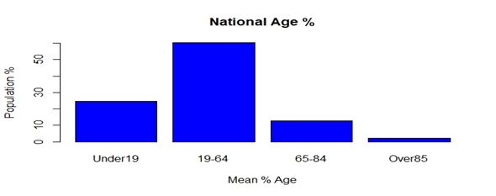
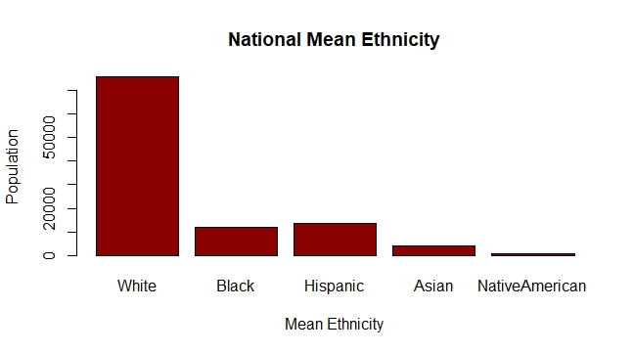
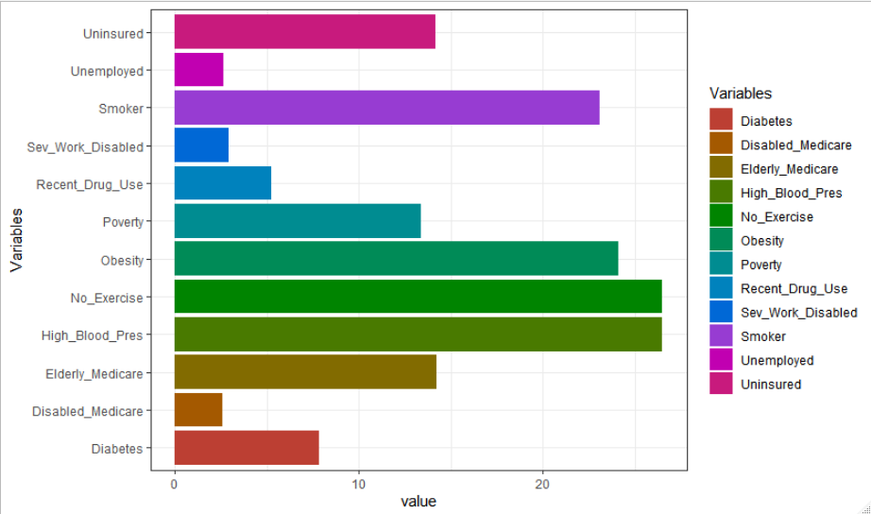
Basic Statistical Analytics
In running basic statistics on the data set (age, gender, race, urbanicity, etc.) most of the data was as expected based on national (census) averages. However, we found the data within age (buckets) to be too tight, didn’t allow for additional stratification (e.g. MCR eligible, etc.)
Interesting statistics and data patterns began to emerge when looking at population health metrics (such as @ risk populations).

Slide 6
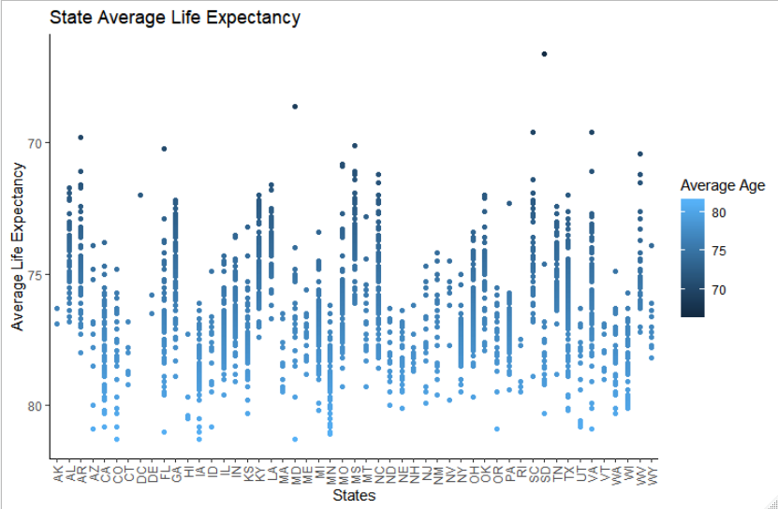
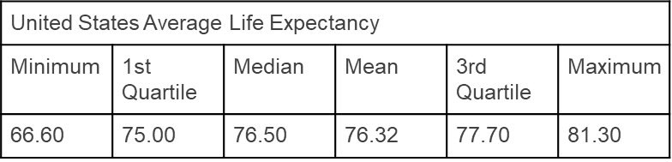
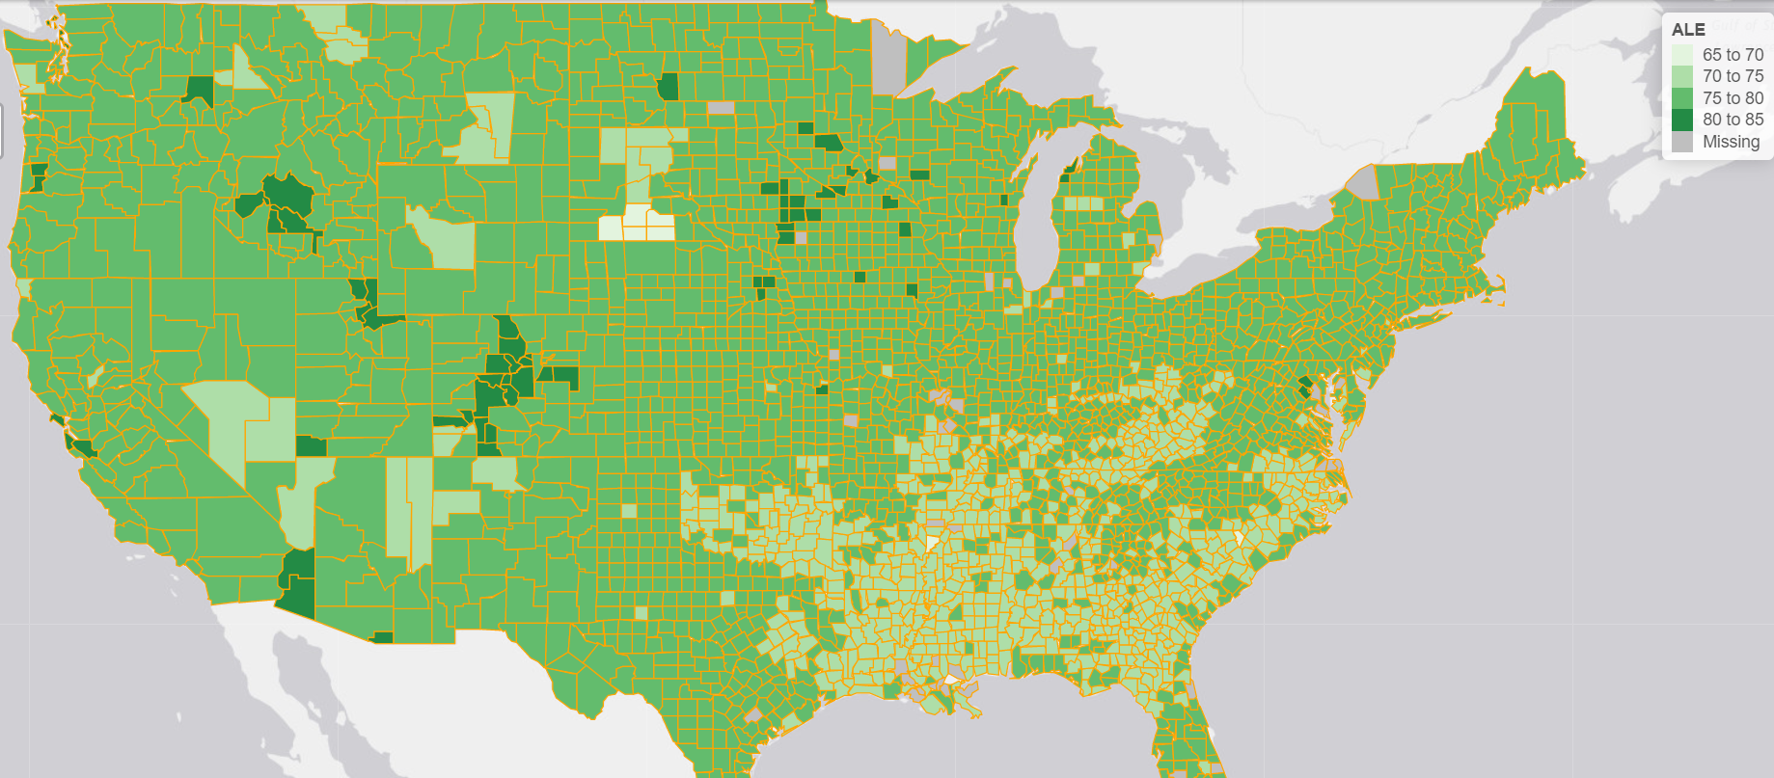
ALE (Average Life Expectancy)
Looking at the @ risk populations led us to further explore ALE. In analyzing the life expectancy of the United States, we took summary statistics to learn more about the break down of each county.
Summary statistics on the average life expectancy of U.S. counties
Avg life expectancy of each county, grouped by state.
Interactive map showing avg life expectancy of each county, grouped by state

Slide 7
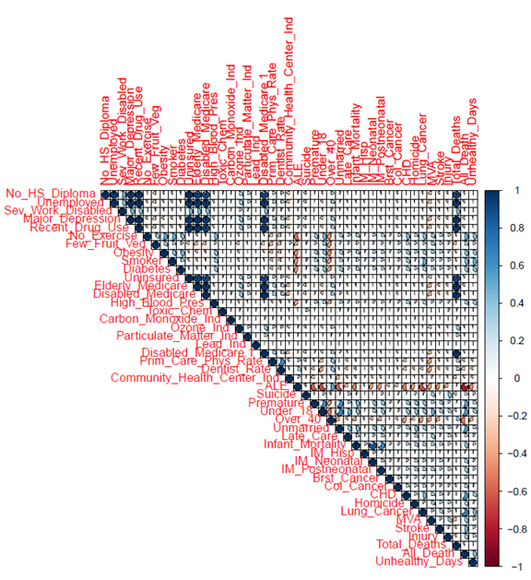
Correlations
Summary Observations:
Positive Correlations (Death Rate to Vulnerable Populations)
No High School Diploma
Unemployed
Major Depression
Recent Drug Use
Elderly and on Medicare
Disabled and on Medicare
No Health Insurance (not surprisingly) and not surprisingly
Negative Correlations (Average Life Expectancy to Risk Factors)
No Exercise
Eat Few Fruits or Vegetables
Smokers
Obese

Slide 8
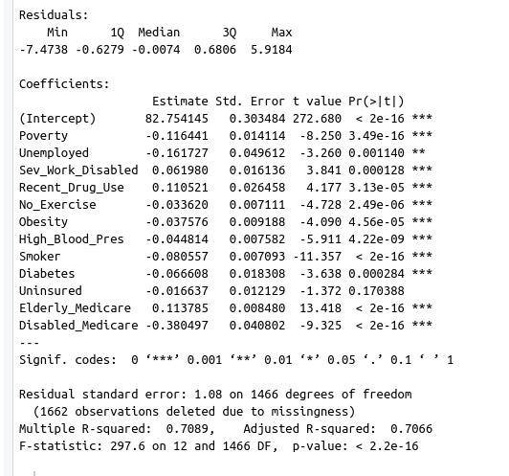
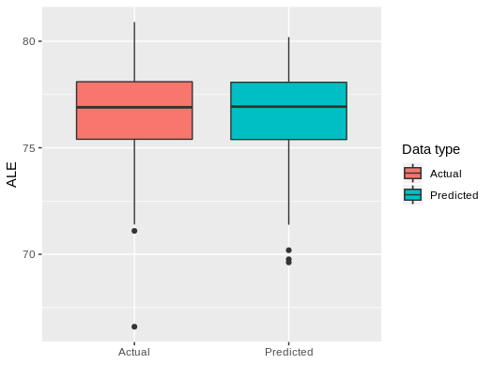
Predictive Analytics
Q: Could we create a model that would allow us to predict life expectancy given a set of variables (thereby allowing a community health director the ability to support programs with impact analysis)?
Several variables were considered and we ultimately chose several of interest: Poverty, Unemployed, Sev_Work_Disabled, Recent_Drug_Use, No_Exercise, Obesity, High_Blood_Pres, Smoker, Diabetes, Uninsured, Elderly_Medicare, and Disabled_Medicare
LM: With an Adjusted R-squared of 0.7066, we can explain quite a bit about average life expectancy using this model.
Using KSVM from ‘kernlab’ we performed cross-fold validation on a training set using 70% of our data. We saw low training error, so continued to check predictions against the testing data.
Testing the predicted numbers against the actual testing ALE, we see the following:
Actual average: 76.68201 (years)
Actual deviation: 1.924118 (years)
Predicted average: 76.6573 (years)
Predicted deviation: 1.906623 (years)
Actual/predicted difference: 0.7858914 (years)
Percent accuracy: 98.96903 % / RMSE is ~ 1.056212
In other words, this is a very good model that predicts life expectancy variation from the inputs we selected. Comparison boxplots look like this:

Slide 9

Q&A
If you’re interested in learning more about ALE in your own home county, follow this link http://rpubs.com/randallscott25/526493 to find out now!

